Slide 1
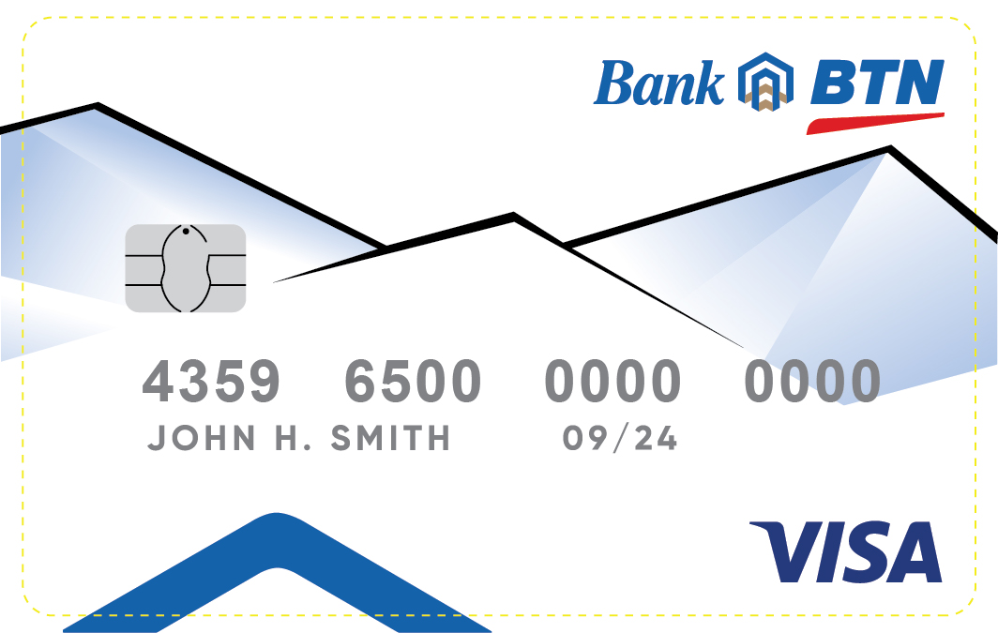
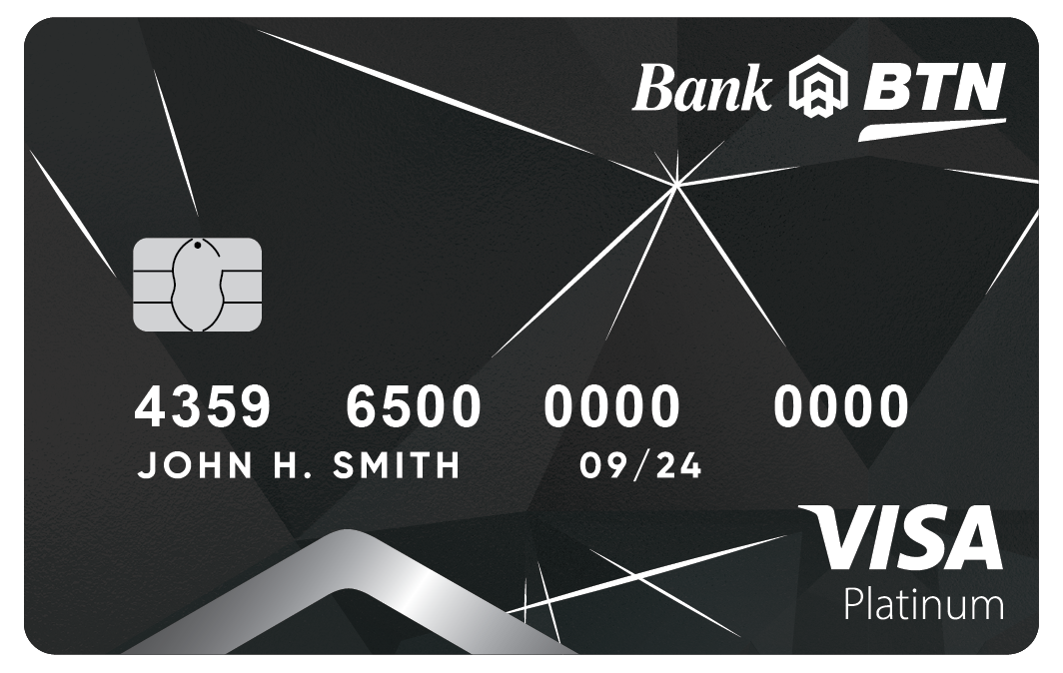
BTN Regular Card
4359 6501xx xxxx xxx
BTN Platinum Card
4359 6502xx xxxx xxx

Slide 2
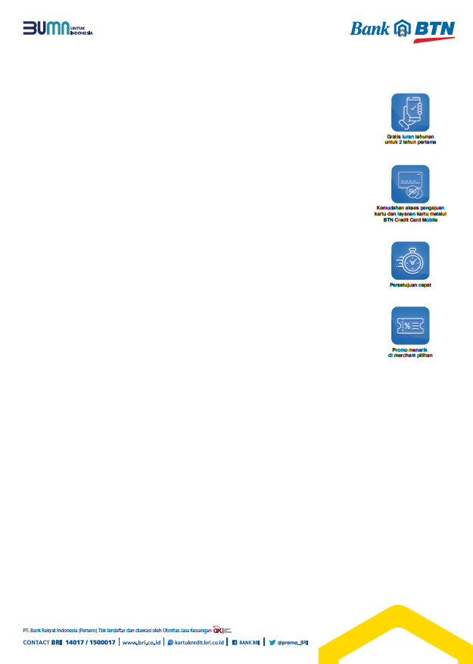
Desain billing bagian depan kartu BTN Gold dan Platinum sama
Informasi mutasi BRI Point tidak usah ditampilkan

Slide 3
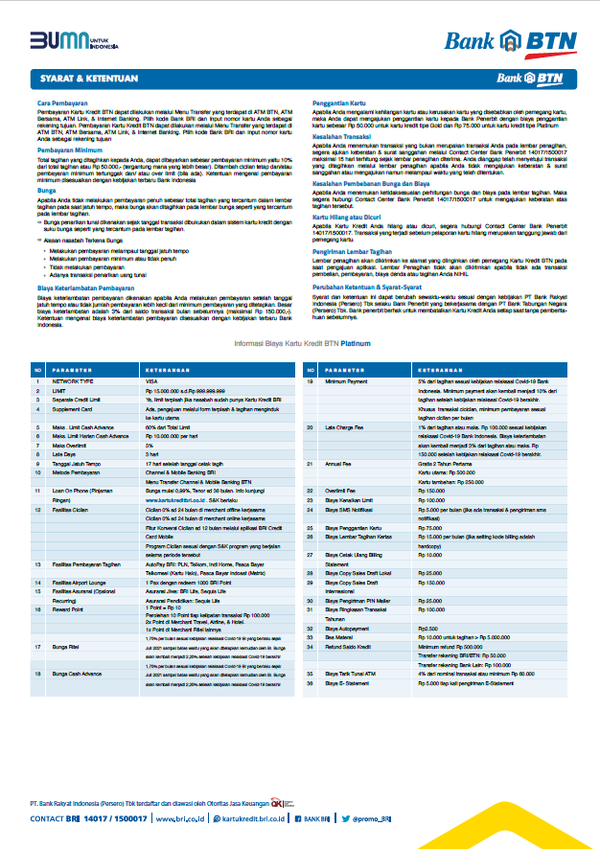
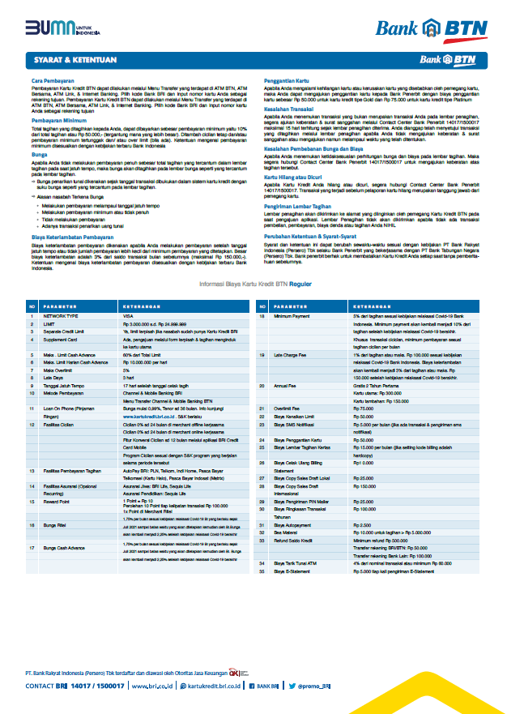
Desain billing bagian belakang kartu BTN Gold dan Platinum berbeda
BTN Platinum Card
4359 6502xx
BTN Regular Card
4359 6501xx

Slide 4
No Kartu Sampel BTN
4359650180008105
No Kartu Eks Hana Gold yang dikecualikan
4359650100032409
4359650100028605
4359650100027201
4359650100033704
4359650100005009
4359650200026400
4359650100011007
4359650100033209
4359650280004608
4359650200014000
4359650100005108
4359650180007107
4359650100029306
4359650100031500
4359650180003403
4359650100023200

